Slide 1


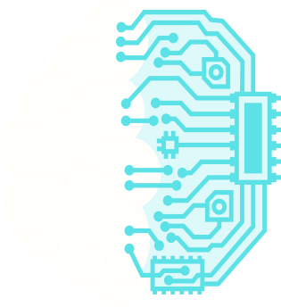
KNOWLEDGE WEB
Connect your idea and discover patterns
In a world drowning in information, one app dares to connect the dots, transforming scattered data into a galaxy of personal knowledge.
DOWNLOAD NOW

Slide 2

The Problem and Solution
The Problem:
Scattered Information: Our digital notes are fragmented across countless apps.
Lost Connections: We lose the valuable relationships between our ideas.
Blocked Insight: This chaos prevents us from seeing the bigger picture.
The Solution:
Centralize: Knowledge Web brings all your ideas into a single, visual hub.
Connect: It maps the relationships between topics, revealing hidden patterns.
Clarify: It transforms clutter into clarity, unlocking new insights.

Slide 3
User Persona
Occupation: PhD Candidate, Age 28
Goal: To bring together complex information and discover new connections for his dissertation.
Frustration: “My notes are all over the place! I can’t see how everything connects.”
Behavior: Spends hours researching online and often sketches mind maps on paper to make sense of ideas.

Slide 4
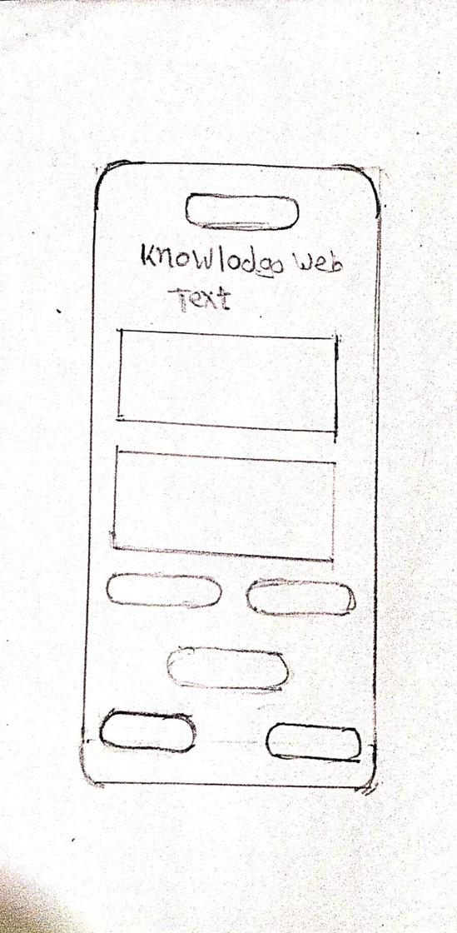
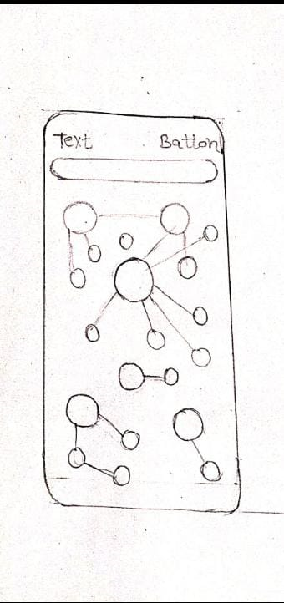
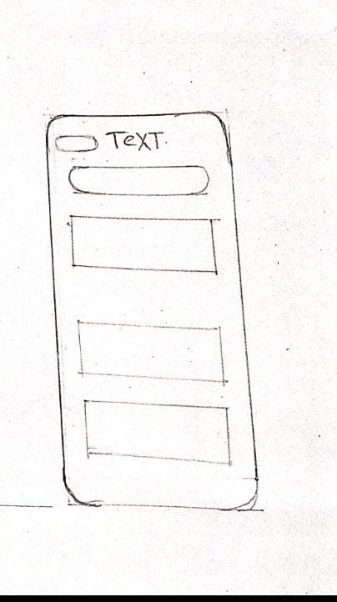
Paper Prototype

Slide 5
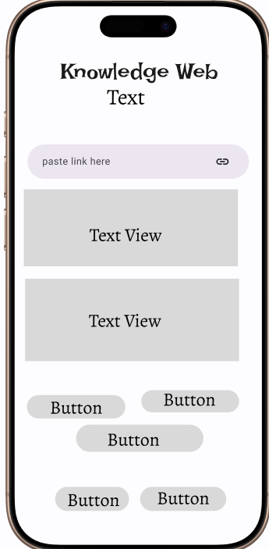
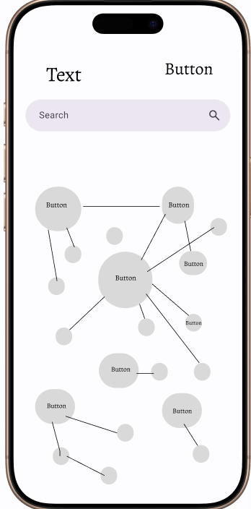
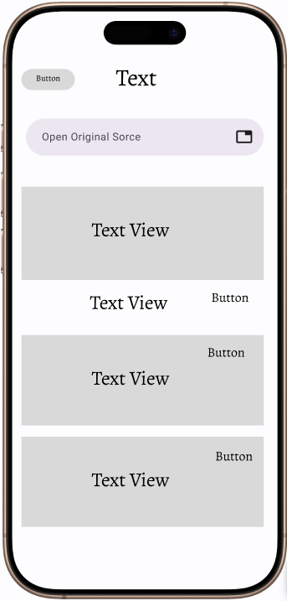
Wireframes (Low-Fidelity)

Slide 6
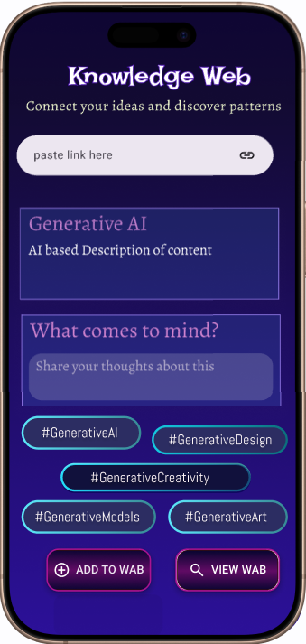
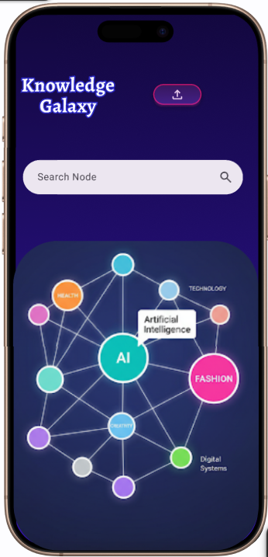
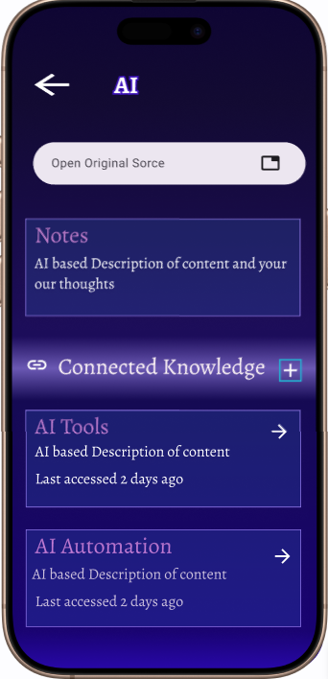
Wireframes (high-Fidelity)

Slide 7
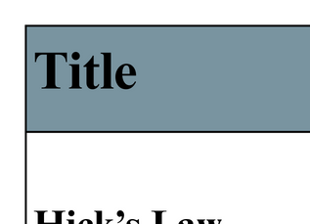
Cognitive Psychology Principles

Slide 8
Thank you
Mosam Doshi
A004
45618230039

